Slide 1


Tokyo Airbnb – Non-Technical Presentation
Date: October 3rd 2020
Presenter: Rick Takeuchi

Slide 2
Increasing overall revenue for Tokyo Airbnb by 40% requires either finding optimal neighborhoods for Airbnb bookings or discovering key variables that increase booking prices
!
Through the increased demand for Airbnb reservations, operational costs increased to host new listings. Too many listings in unideal areas will create potential deficits.
Problem 1:
Increased number of listings requires discovering ideal neighbourhoods for Airbnb development
!
People use Airbnb because of lower booking prices compared to hotels. Unfortunately, lower mean booking prices led to lower overall revenue. However, cost-effective listings can be used for budget travelers.
Problem 2:
Overly lower booking prices are detrimental to overall Airbnb regional revenues
!
Number of customers for Airbnb visits are highly impacted by previous customers’ reviews. If reviews are lower, smaller number of customers and potentially lower booking prices will make Airbnb unsuitable both in short and long term.
Problem 3
Lower review scores will lead to less customers and revenues in the future

Slide 3
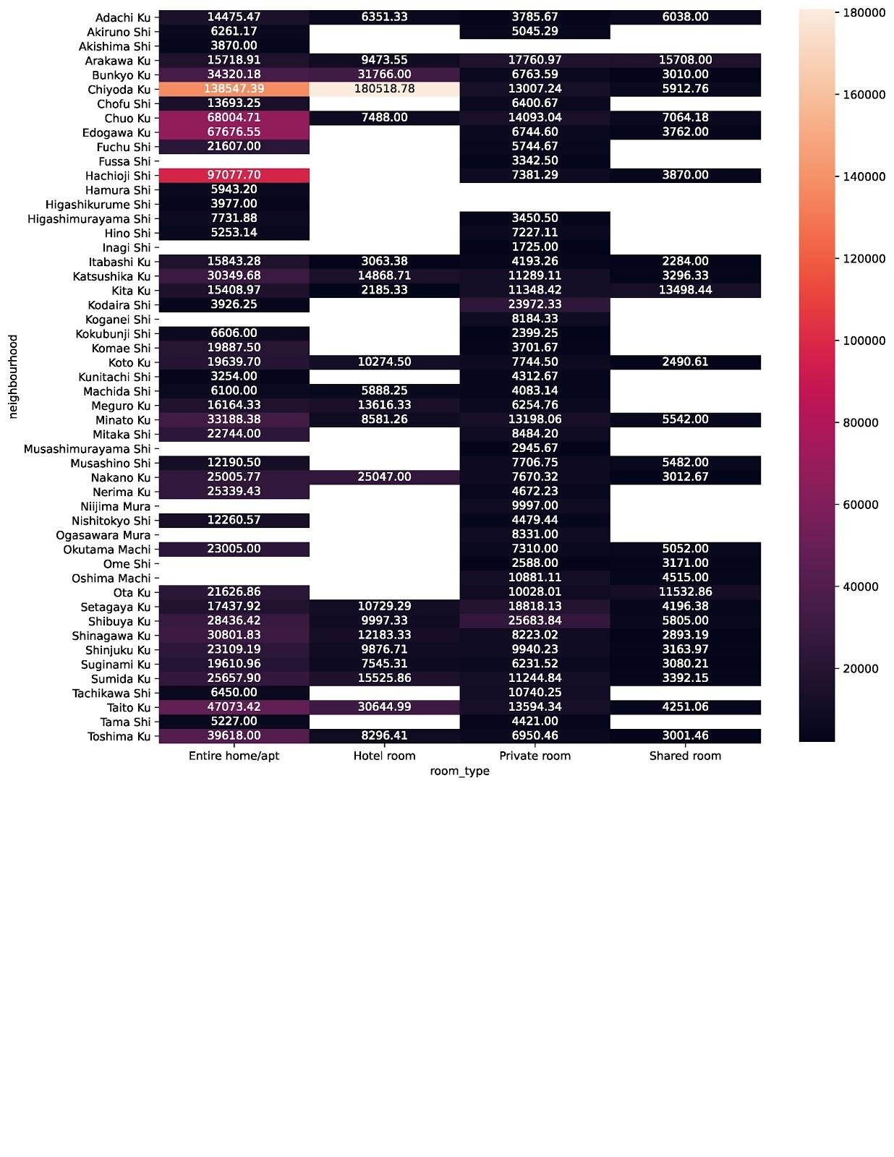
Neighborhood vs Property Type Shade Chart

Slide 4
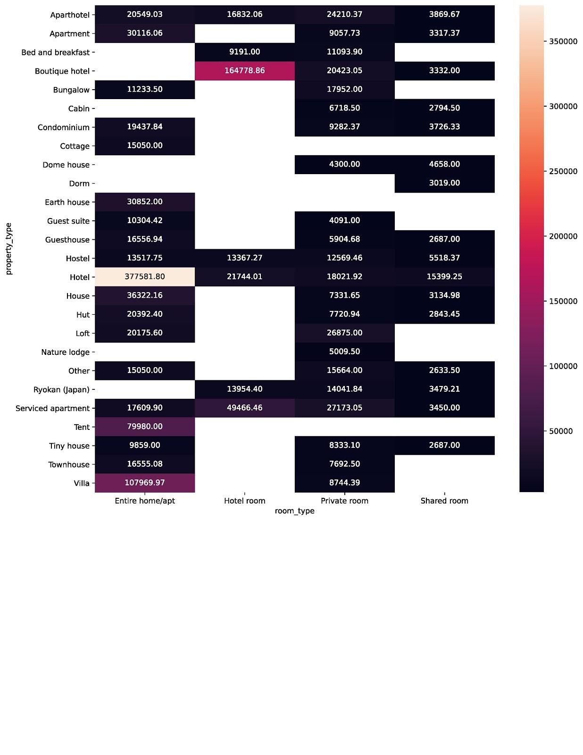
Through utilization of descriptive and inferential statistics, three (3) key variables that largely impact pricing of the property, enables two (2) heat maps capable of identifying ideal property types.
Statistical
Methodologies
Visual
Methodologies
Key Insights
Heat Maps: Through two charts: property type vs room type and property type and neighborhood, most cost effective and priciest property types are indicated numerically and in color shade. The lighter the color, more expensive the property listing is.
Fluid Insights: Visual and statistical methodologies are used to two distinct heat maps. Further analysis of heat maps signals that more insights are needed to be made to discover key variables that impact booking prices. Lack of further insight will potentially decrease revenue and increase operational cost drastically.

Slide 5
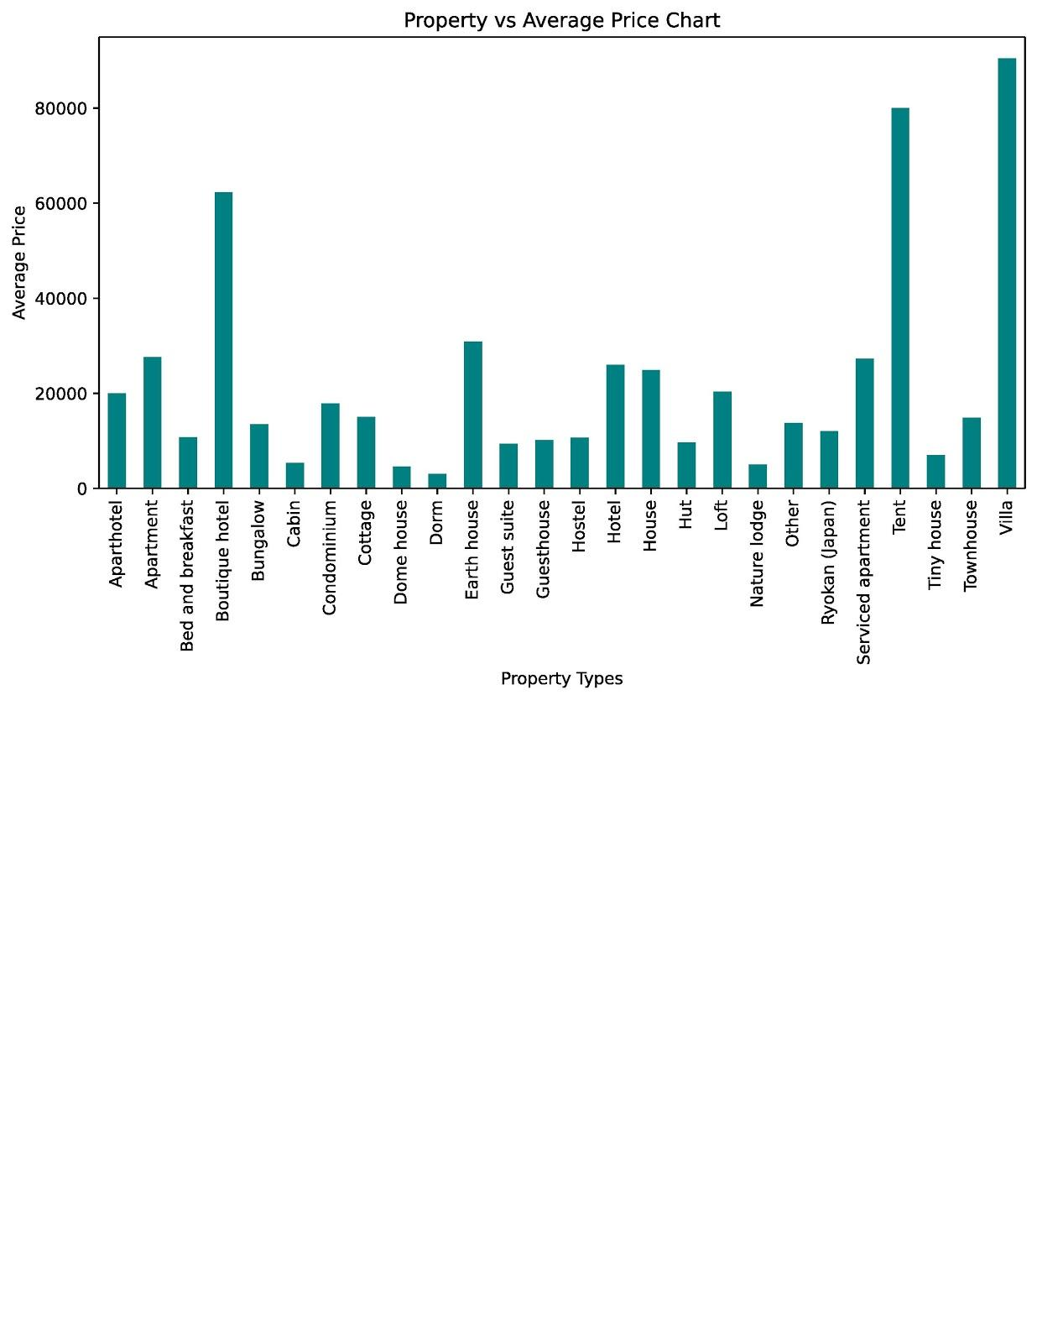
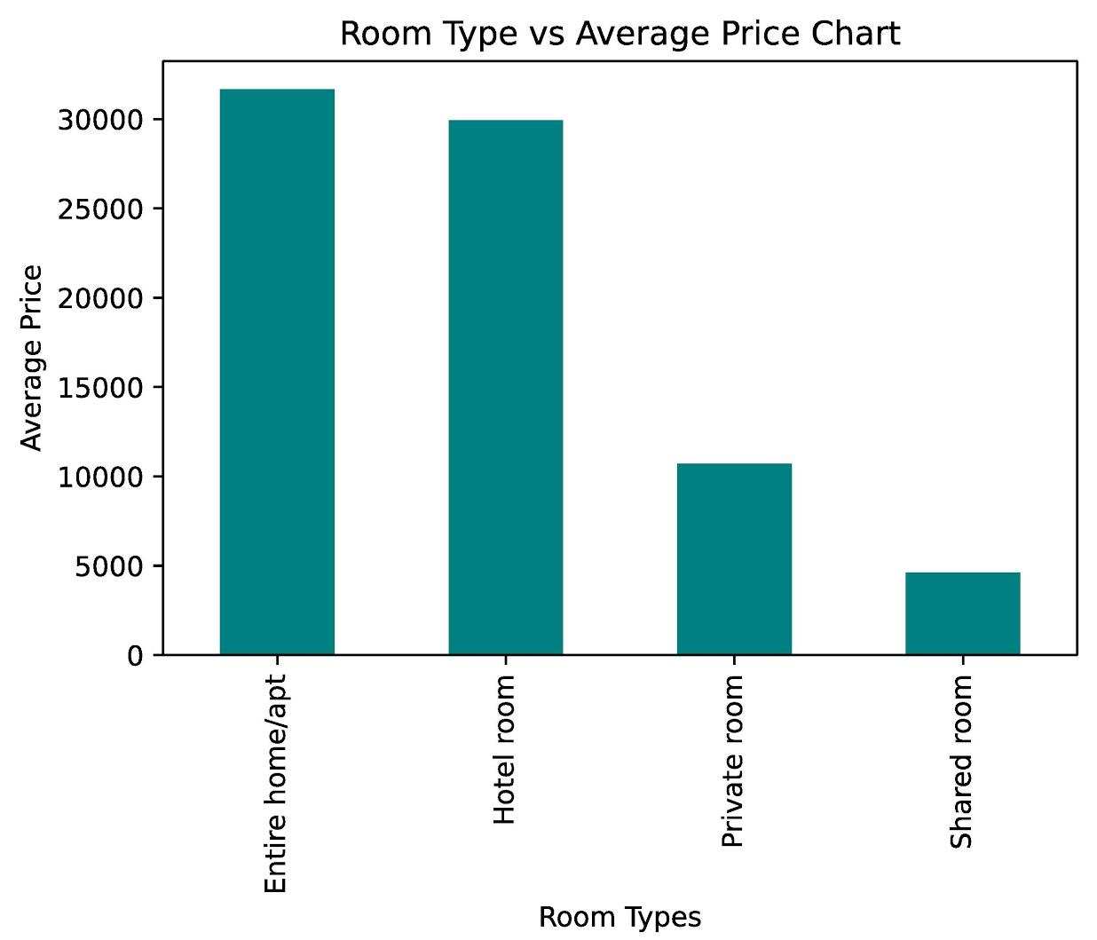
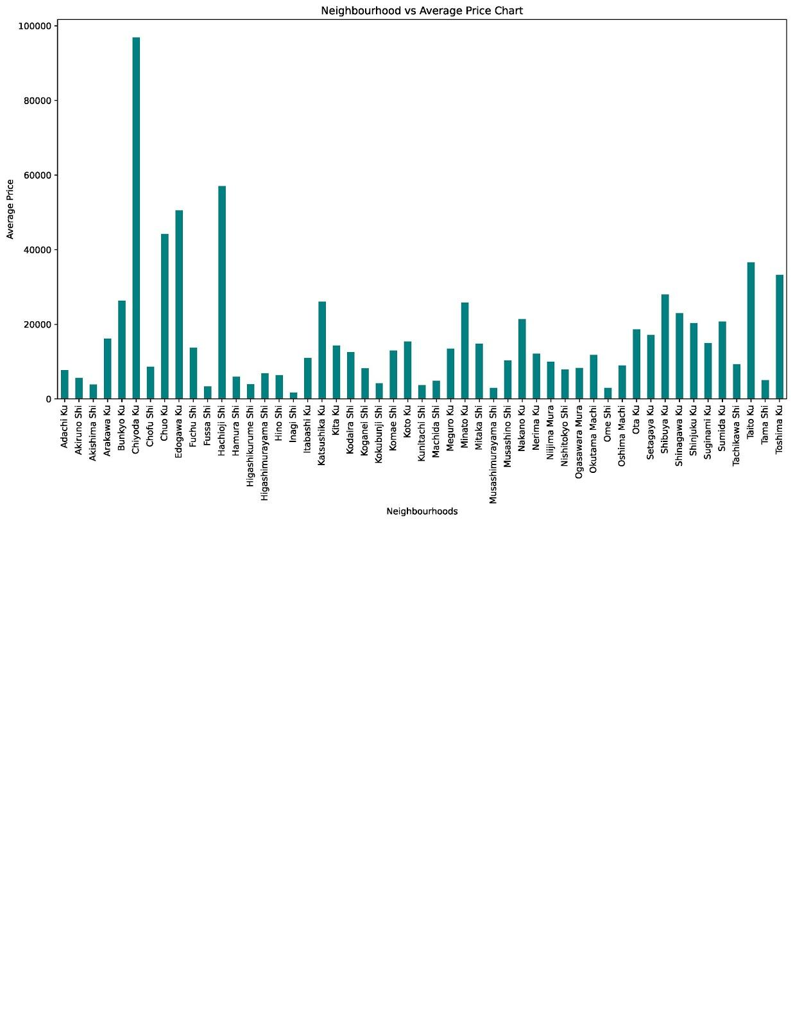
Discovering key insights through visualization methodologies resulted in three major discoveries that can generate more revenues
Key Insights
The average price of an entire home/apt is a lot higher than a private room and shared room. In order to generate more revenue, Airbnb must list more entire homes and apartments due to larger portions of these types of listings and higher average price.
High occupancy rates in lowest price neighborhoods and/or property types can generate revenue if Airbnb caters these listings to low budget travelers and student travelers.
Most expensive property types can only generate large revenues if someone is interested in investing or renting these types of properties.
.

Slide 6
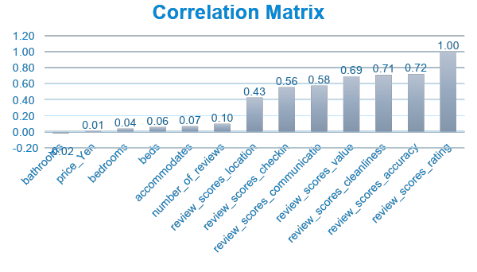
Further analysis of the dataset where the Airbnb listing reviews yielded three (3) key signals that strongly correlated with overall reviews which boosted our confidence in the trend picked up in descriptive analysis.
Key Insights
Through utilizing a measure known as correlation which indicates how closely a variable is associated with “Overall reviews” (AKA review_scores_rating), we were able to identify three (3) key variables customers pay most attention to. A correlation score is is returned with number closer to 1, indicating the variable is closely related to overall reviews. However, “Overall reviews” have solid correlation with three review subcategories in particular.
Accuracy: 0.72
Cleanliness: 0.71
Value: 0.69

Slide 7
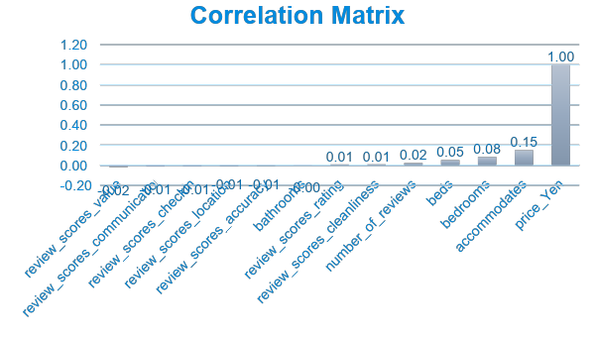
Further correlation analysis for listing price with other variables yielded no variables that are strongly correlated with property price, which reduced our confidence in finding quantitative variables related to listing price
Key Insights
Through utilizing correlation again with listing price (price_yen), there were no variables that strongly correlated with listing price of Airbnb properties. A correlation score is is returned with number closer to 0, indicating the variable has little or no correlation with listing price. However, listing price have small correlation with three review subcategories in particular.
Accommodates: 0.15
Bedrooms: 0.08
Beds: 0.05

